Slide 1
Power BI Sales

Slide 2
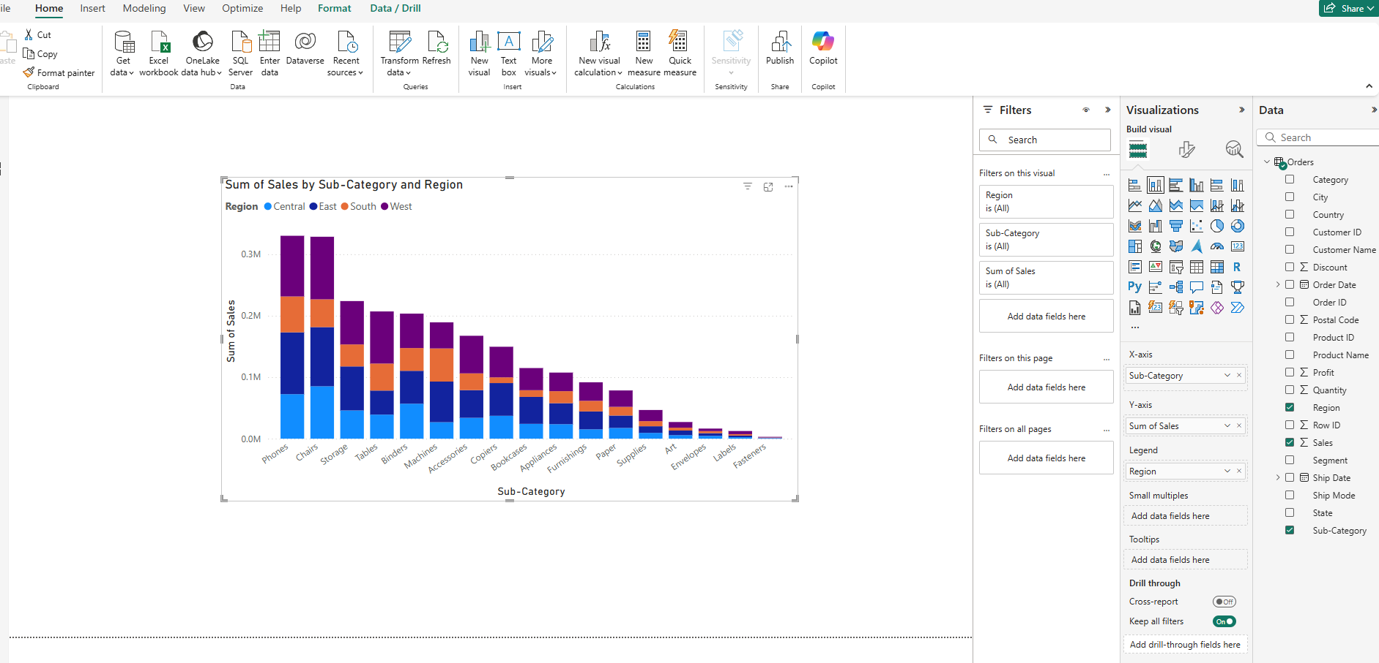
Open power BI: Import data from excel -> Load Sales.order data…do not transform since we are not doing any cleaning,etc
In visualization, click stacked bar chart and then choose sales + sub-category. This will create the bar chart. Now click on the region.
Now change it to stacked column chart.
Now change the y-axis to see mean, min, max, etc. Change colors, legend->position, Enable data labels and describe this,etc
Explain Include and exclude(select 2-3 bars with ctrl and then RC…)

Slide 3
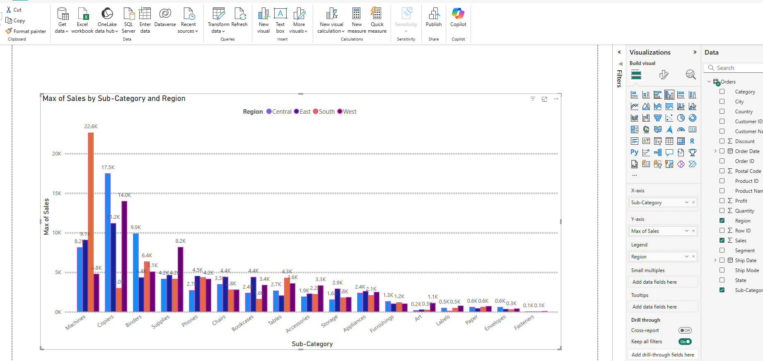
Now add a new page and add clustered bar chart, clustered column chart
Now change the y-axis to see mean, min, max, etc. Change colors, legend->position, Enable data labels and describe this, etc Enable Total labels
Explain: Export the data
E

Slide 4
Now add new page and show conditional formatting
1) Create bar chart from sales and sub-category. -> Format visual -> bars and then color.fx

Slide 5
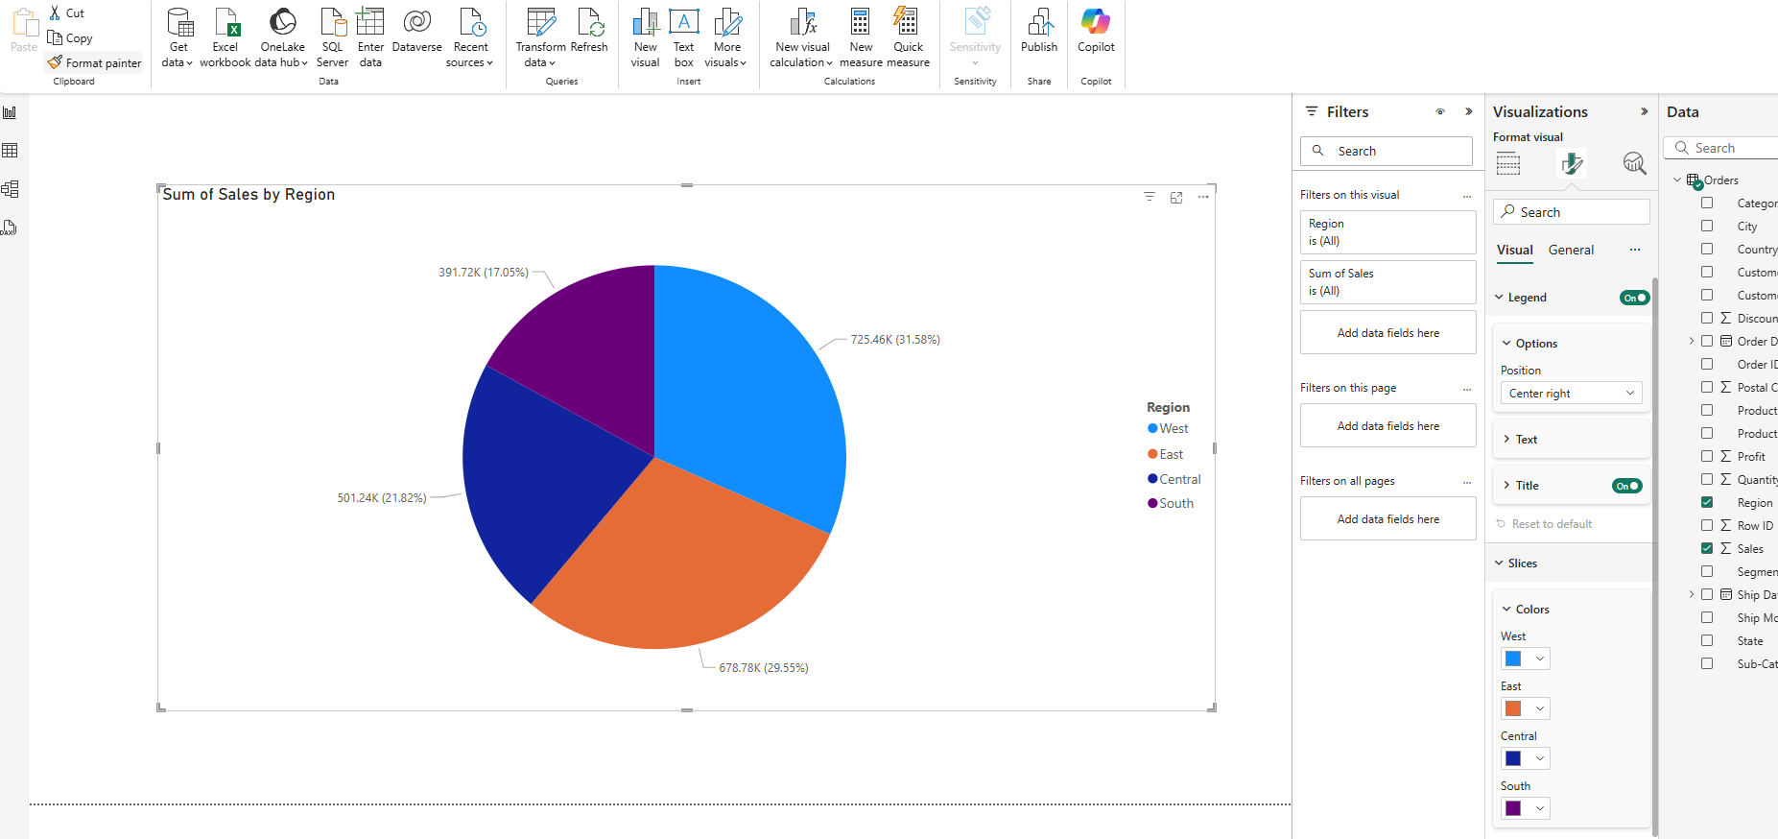
Pie chart: select region and sales
Format your visual-> visual -> experiment with legend, slice, detail labels, rotation
Format your visual-> general -> experiment with title, effects

Slide 6
Now show donut chart

Slide 7
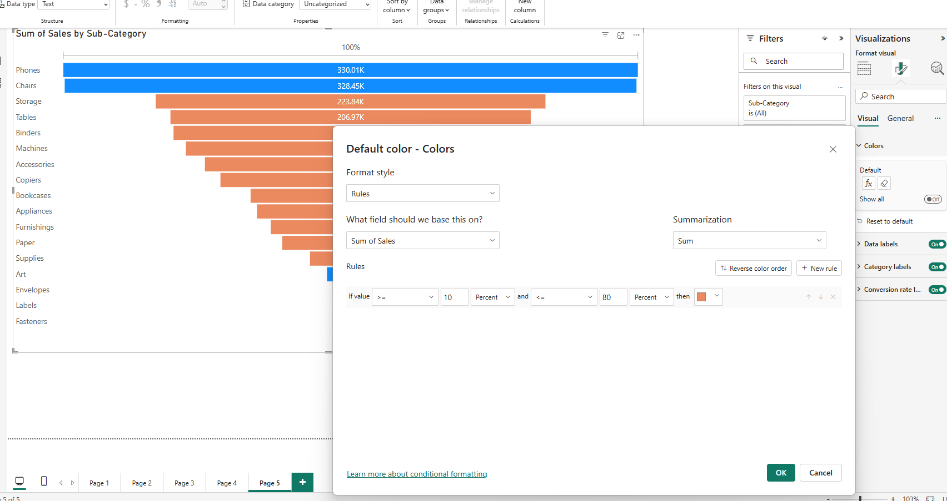
Now show funnel chart: sales and sub-category
Format your visuals: change with things here: visuals -> fx -> use rule based

Slide 8
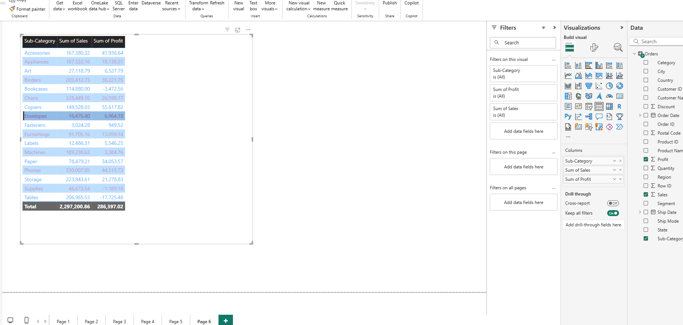
Now show table: Use sub-category, sales , profit

Slide 9
Now show matrix: use sub-category, region , sales

Slide 10
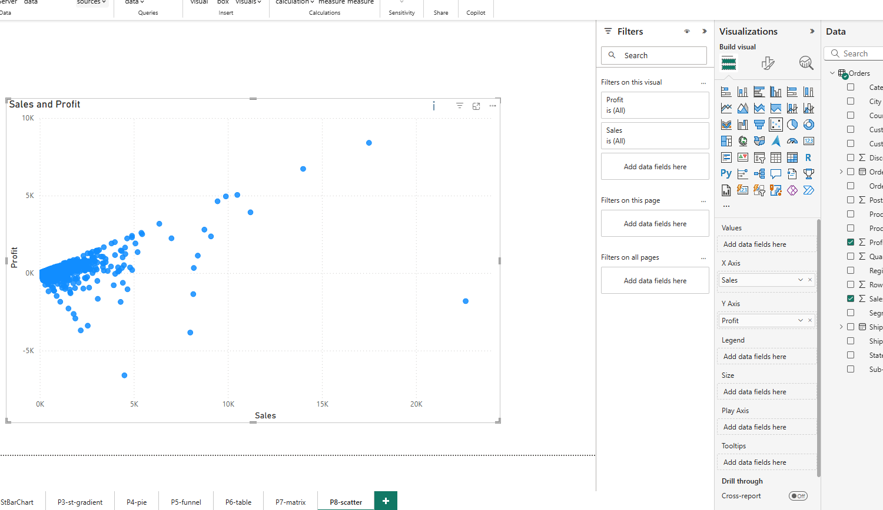
Now do scatter plot: use sales and profit…change x/y-axis to do not summarize

Slide 11
Now we use map: (File -> option and settings -> options -> Global -> security -> check box ‘Use maps and filled maps visuals’)
I used state and sales: Goto general -> map settings -> bubbles and change color fx

Slide 12
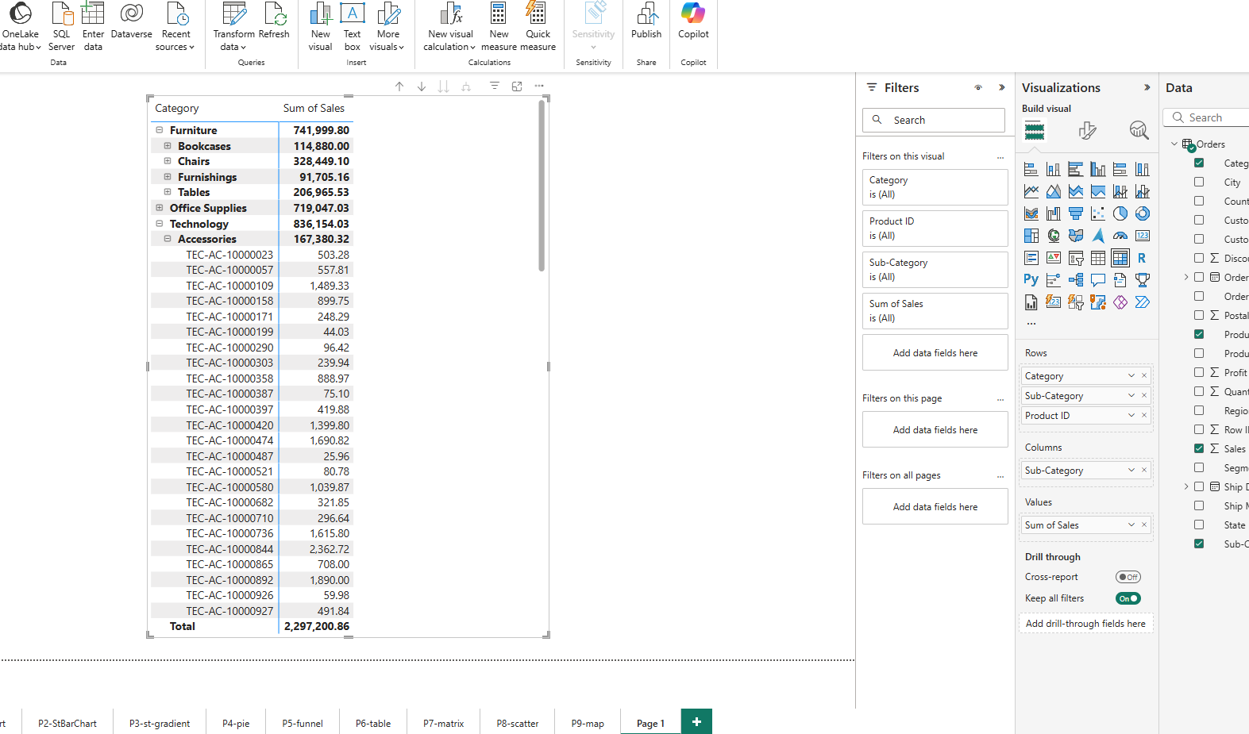
Now we create hierarchies: Click matrix and check category, sales, sub-category, product-id. Drag sub-category and product-id in rows

